Slide 1
AP Computer Science A
Week 6
Changing Variables, Loops and Methods

Slide 2
Changing Variables
You can change variables by using other methods of operation:
++
--

Slide 3
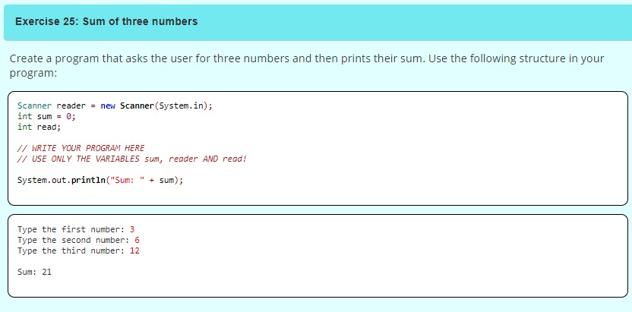
Exercise 25

Slide 4
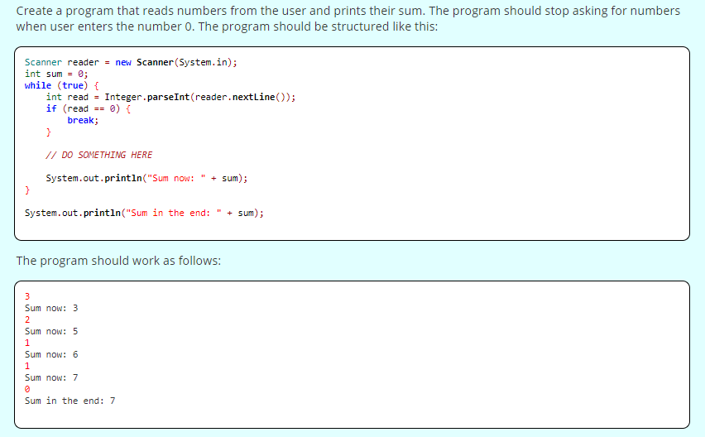
Exercise 26

Slide 5
More Loops
Previously learned about while(true) and break.
But you can use the place where ‘true’ is to define how many loops you want.

Slide 6
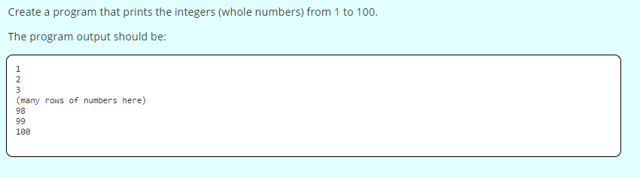
Exercise 27

Slide 7
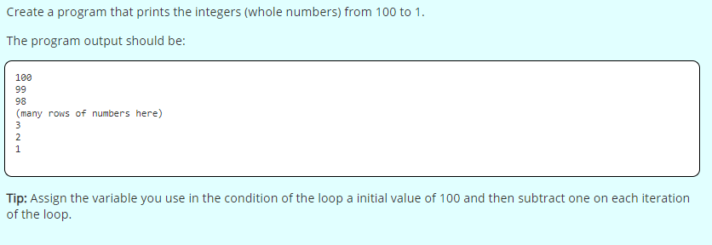
Exercise 28

Slide 8
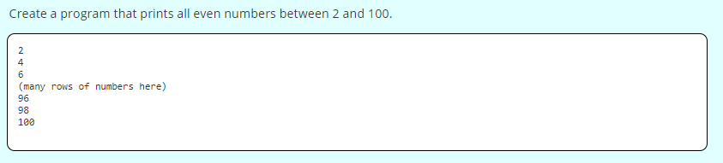
Exercise 29 (BONUS)

Slide 9
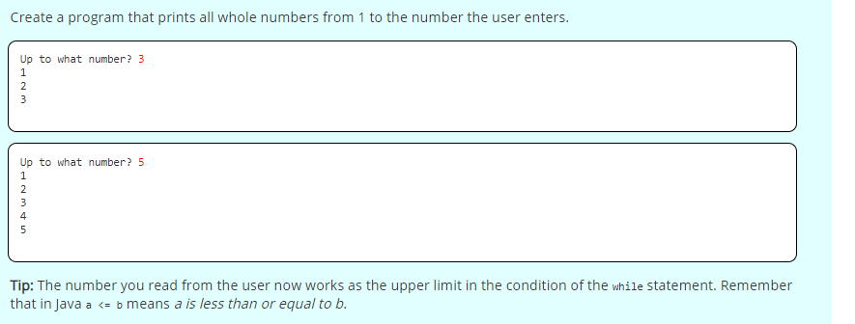
Exercise 30 (BONUS)

Slide 10
Assignment Operations
Changing the value of a variable is used very often, so there are special operations for it:
+=
-=
*=
/=
%=

Slide 11
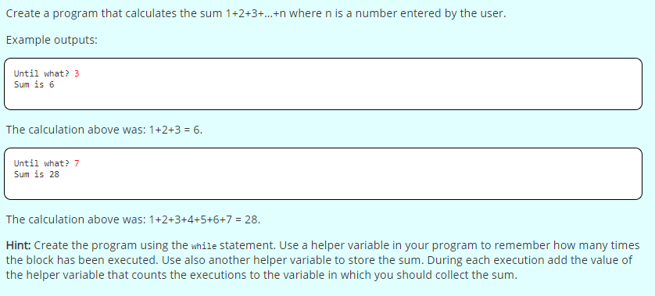
Exercise 32

Slide 12
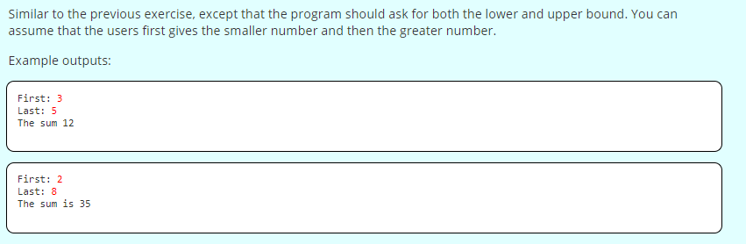
Exercise 33

Slide 13
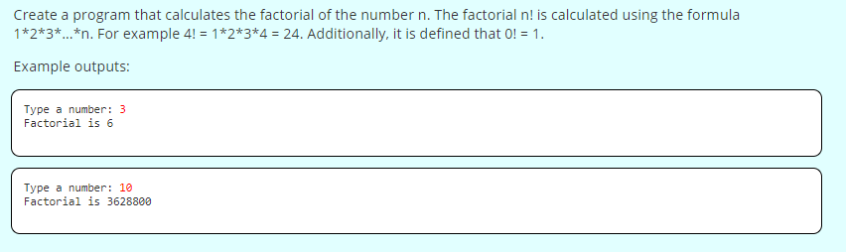
Exercise 34 (BONUS)

Slide 14
Infinite Loop
Be careful! If you do not structure your while loop properly, it will run forever…

Slide 15
Infinite Loop
Be careful! If you do not structure your while loop properly, it will run forever…

Slide 16
Ending a while Loop
You can end a while loop two ways:
With an iterator that ends after a condition is met
With a while(true) and a break.

Slide 17
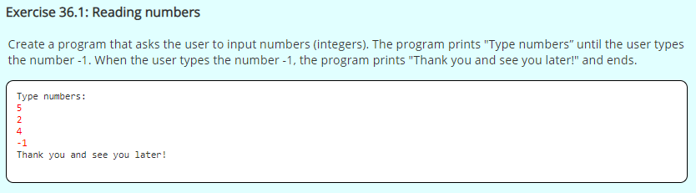
Exercise 36 Part 1

Slide 18
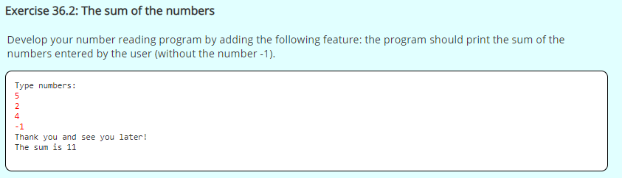
Exercise 36 Part 2

Slide 19
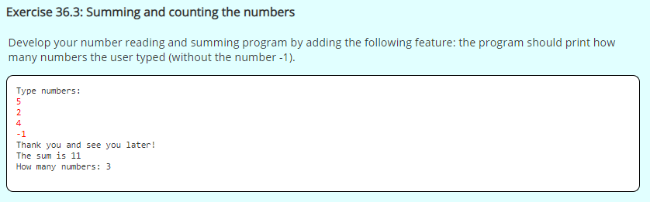
Exercise 36 Part 3

Slide 20
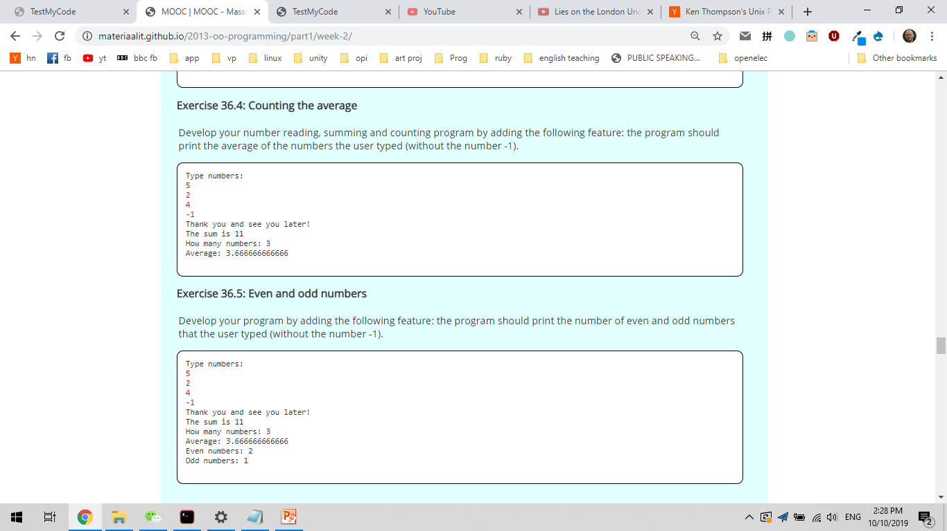
Exercise 36 Part 4 (Bonus)

Slide 21
Exercise 36 Part 5 (Bonus)

Slide 22
Methods
If we look at the commands we have used System.out.println(“Hello”) and Integer.parseInt(test), they are not commands, but they are called methods
You can find a method based on the dot (.) the name starts after it. Ex. Integer.parseInt(test)

Slide 23
Making our own Methods
public class ProgramBody {
public static void main(String[] args) { Scanner reader = new Scanner(System.in);
// program code
}
// self-written methods
}

Slide 24
Making our own Methods
public class ProgramBody {
public static void main(String[] args) { Scanner reader = new Scanner(System.in);
// program code
greet()
}
public static void greet() { System.out.println("Greetings from the world of methods!");
}
}

Slide 25
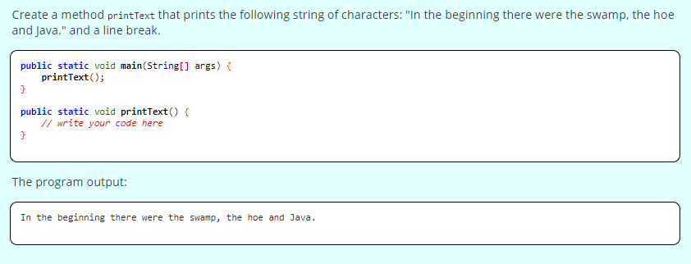
Exercise 37

Slide 26
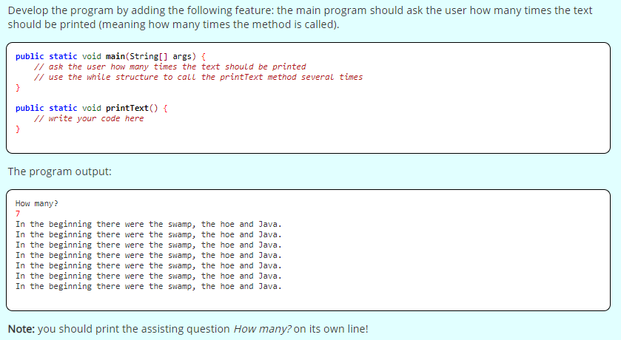
Exercise 38

Slide 27
Method Parameters
We can make methods much more useful giving it parameters.
public static void greet(String name) { System.out.println("Hi " + name + ", greetings from the world of methods!");
}

Slide 28
Many parameters
We can have more than one parameter per method.
public static void greet(String name, String name2) { System.out.println("Hi " + name + “and” + name2);
}

Slide 29
Methods calling other methods
Methods can also be called from outside of main.

Slide 30
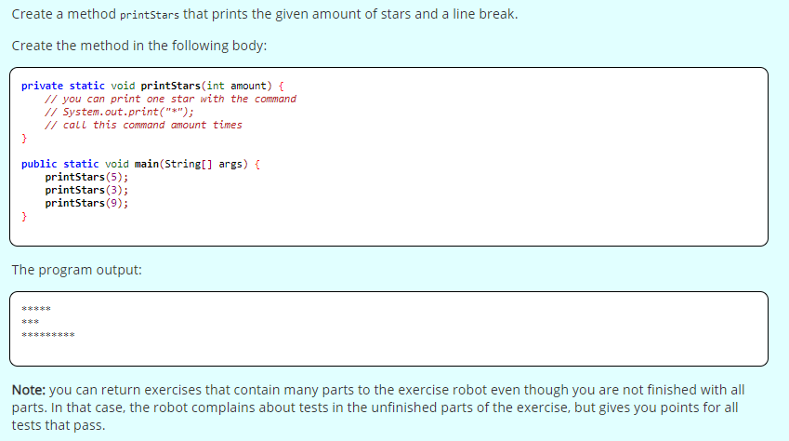
Exercise 39 Part 1

Slide 31
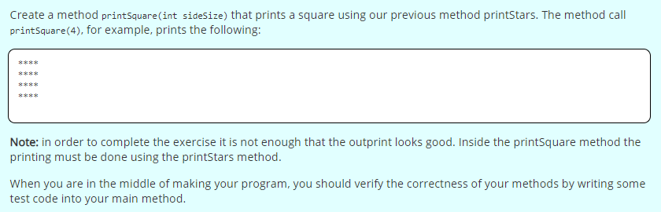
Exercise 39 Part 2

Slide 32
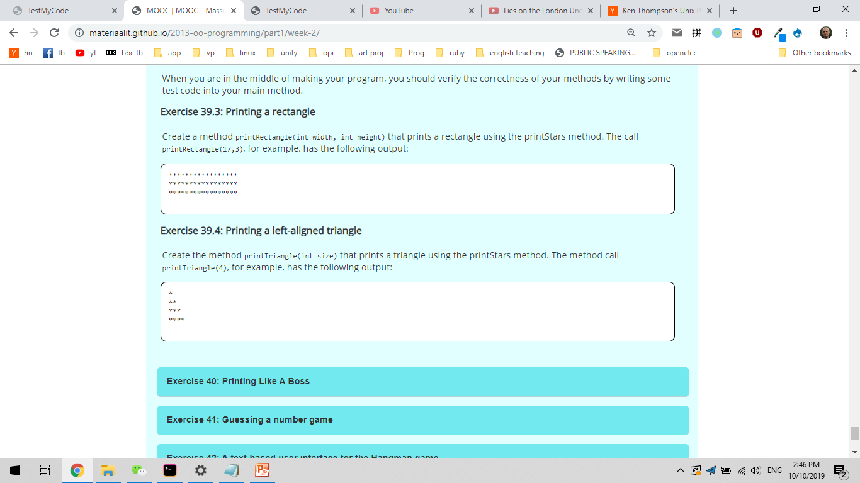
Exercise 39 Part 3

Slide 33
Exercise 39 Part 4

Slide 34
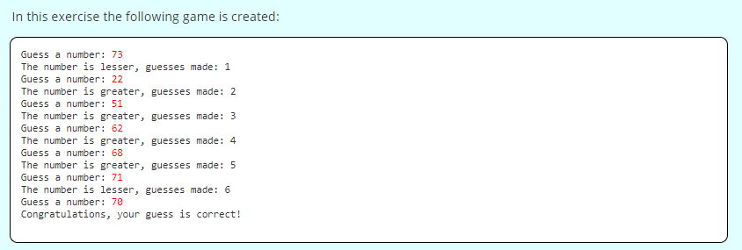
Exercise 41 (BONUS)

Slide 35
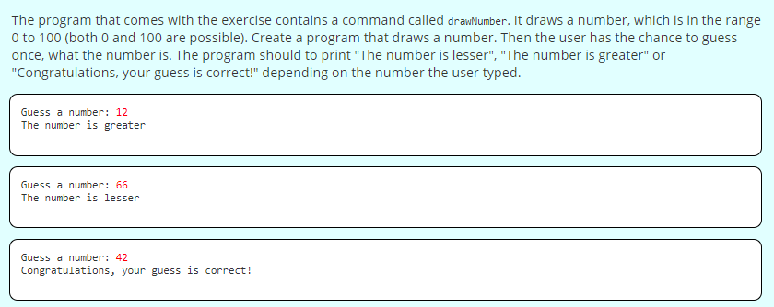
Exercise 41 Part 1 (BONUS)

Slide 36
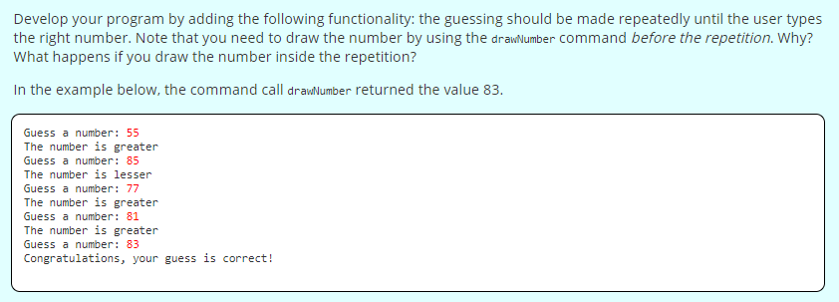
Exercise 41 Part 2 (BONUS)

Slide 37
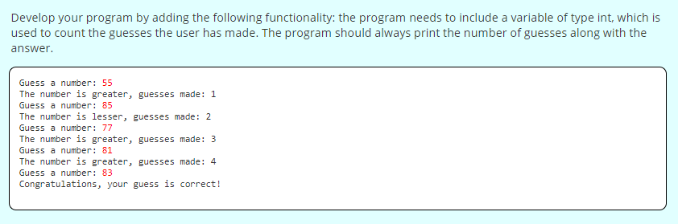
Exercise 41 Part 3 (BONUS)

